Slide 1
CREW INFINITY DANCE STUDIO
GRAND OPENING-WELCOME ALL!!!

Slide 2
FOUNDATION
Team Founded by me in the year 2013
we won 2nd place in 2014
1st place in the year 2016 college festival
Studio Inaugurated on March 25,2019

Slide 3
WHAT WE DO
Western dance
Hip-Hop
Locking
Popping
Folk Dance

Slide 4
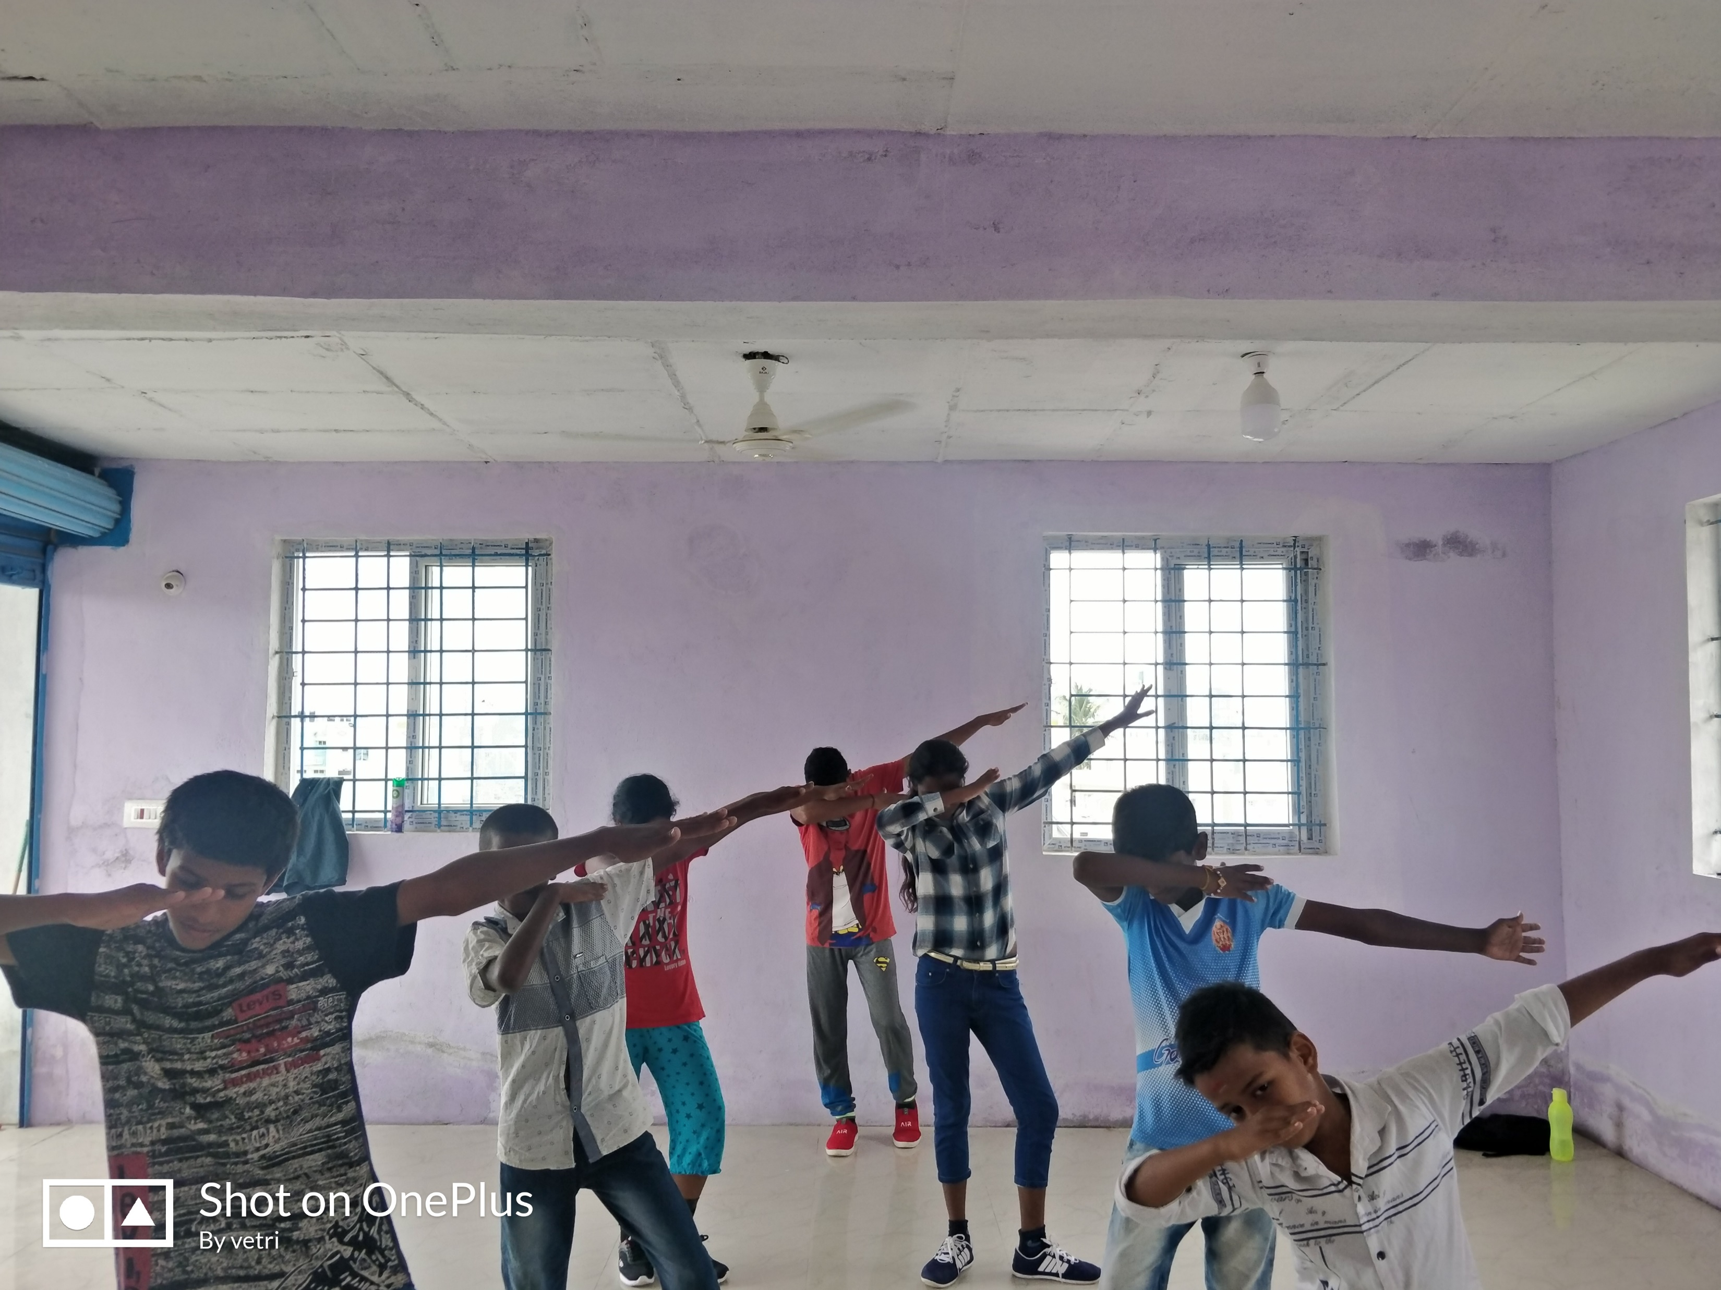
WHAT WE DO
Fitness
Aerobics
Weight loss
Diet plan
Choreography
college Cultural
School completions
TV/Reality show

Slide 5
Events
Marriage/Sangeet
workshop

